Slide 1
Free Space Propagation Model
Why free space propagation model?
Predict received signal strength when the transmitter and receiver have a clear, unobstructed line-of-sight path between them.
Satellite communication systems and microwave line-of-sight radio links undergo free space propagation.

Slide 2
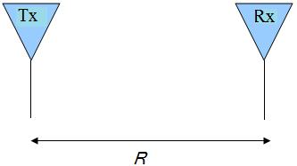

Free Space Propagation Model
Equation for the Free space received power by a receiver antenna (Friis Free Space Equation)
The power density p, flowing through the surface of a sphere of radius R centered at the transmitter
Notes:
the energy radiated by an omni-directional antenna is spread over the surface of a sphere. Transmit antenna modelled as a point source. Transmit power is spread over the surface area of a hypothetical sphere. Electromagnetic Radiation implies that the energy radiates uniformly in all directions, at the speed of light (3×108 m/s or 3.3 µs/km) [1]. This may be viewed as a sphere, expanding in time and space

Slide 3


Free Space Propagation Model
The Power received the by the receiving antenna is
Gain of antenna: Antenna’s ability to direct or concentrate radio frequency energy in a particular direction.
A_{ER} is the antenna aperture or effective area which is a measure of how effective an antenna is at receiving the power of radio waves
Notes:
Antenna gain:A relative measure of an antenna'sability to direct or concentrate radio frequency energy in a particular direction or pattern

Slide 4


Free Space Propagation Model
The effective aperture for any antenna can be expressed as
The resulting received power can be written as:
Received power decays at the rate 20db/decade with distance

Slide 5
Free Space Propagation Model
An isotropic antenna is an ideal antenna which radiates power with unit gain uniformly in all directions.
Effective isotropic radiated power is
EIRP = P_{t}G_{t}
Magnitude of the received E field
ΙEΙ = ( P_{r}(d)120π/A_{e})^{1/2}

Slide 6
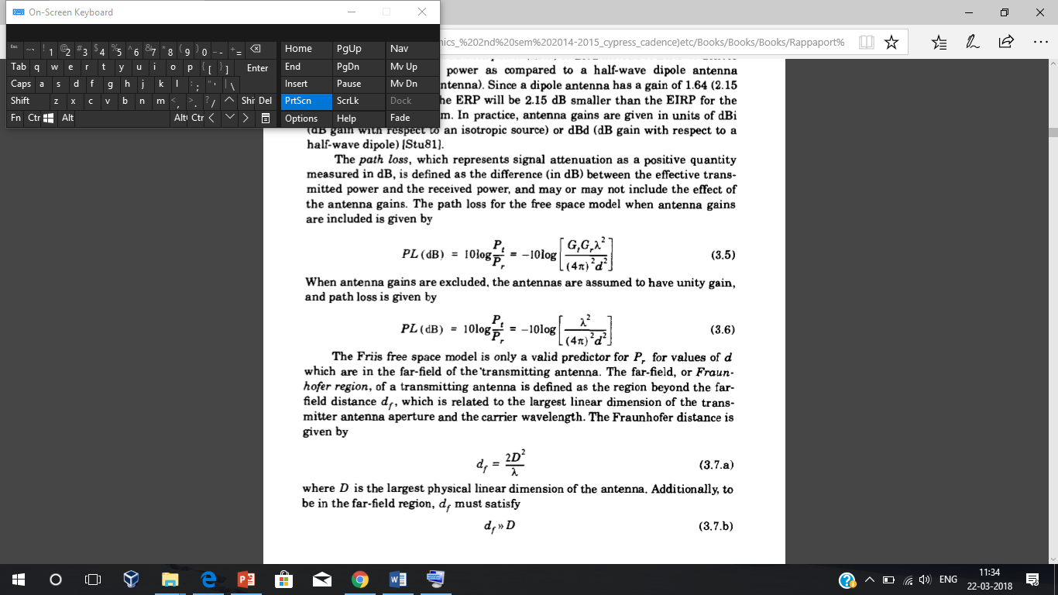
Free Space Propagation Model
Path loss represents the signal attenuation and is measured in dB.
If unit gain antennas are considered ,

Slide 7
Fields of Antenna
The fields of an antenna can broadly be classified in two regions
Far field
Near field
The Friis free space model is only a valid for values of d which are in the far-field of the transmitting antenna.
It is in the far field that the propagating waves act as plane waves and the power decays inversely with distance.
The far field region is also termed as Fraunhofer region

Slide 8
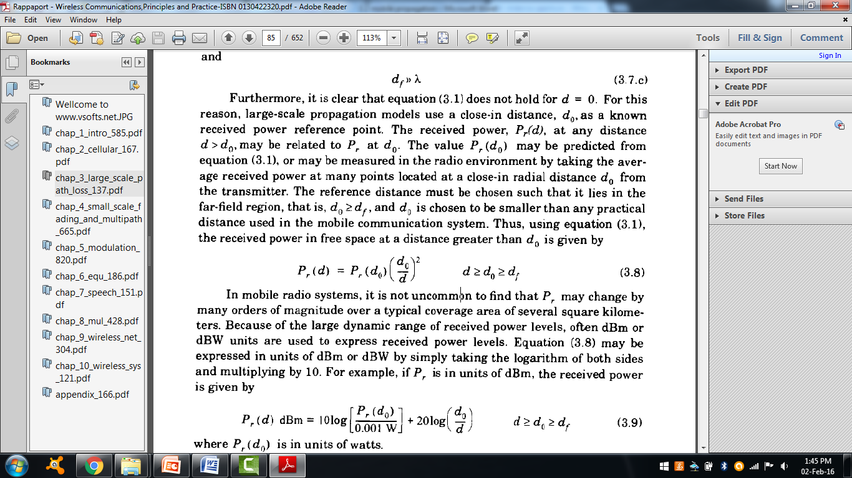
Free Space Propagation Model
The Fraunhofer distance is given by
df = 2D²/λ.
D- largest physical linear dimension of the antenna
Large-scale propagation models use a close-in distance, d0, as a known received power reference point.
Received power in free space at a distance greater than d0 is given by

Slide 9
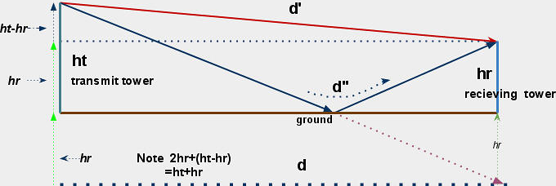
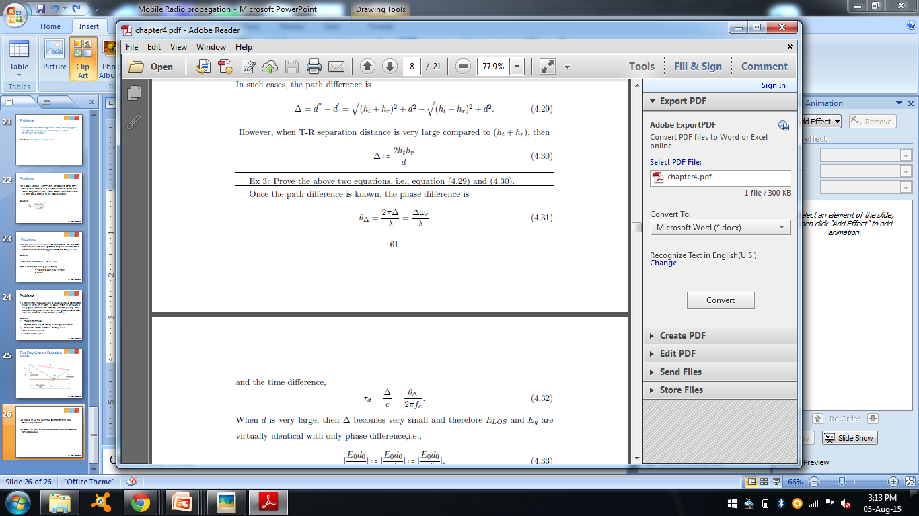
Two Ray Ground Reflection Model
if d>> ht+hr

Slide 10
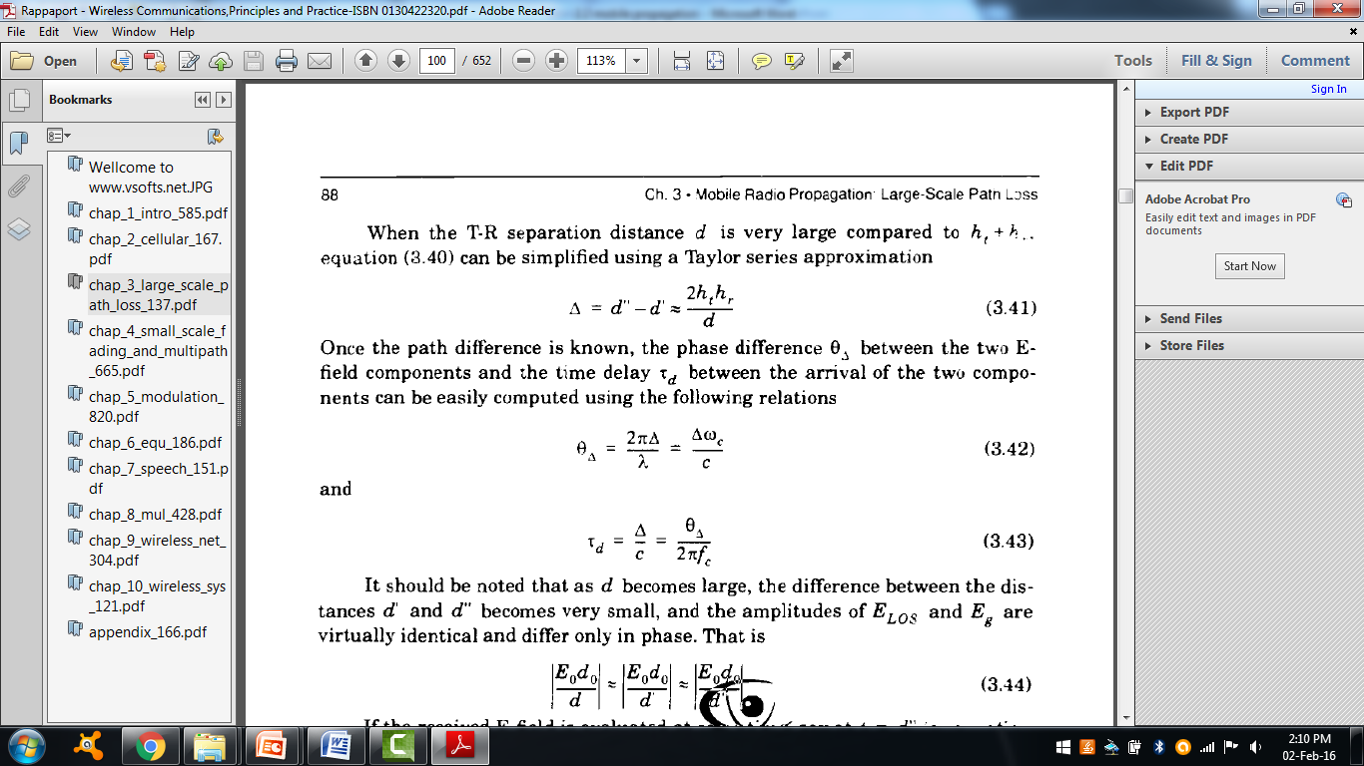
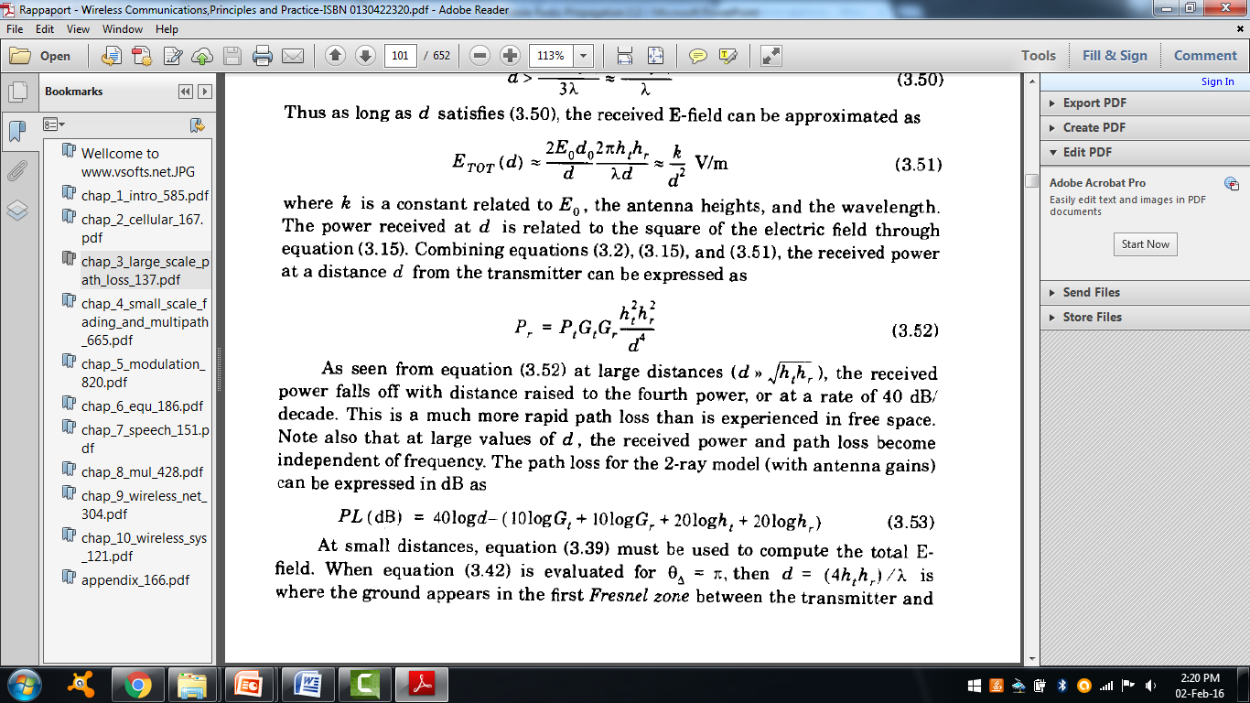
Two Ray Ground Reflection Model
Received power at a distance d from the transmitting antenna is

Slide 11
Summary
Free space propagation model is used to predict received signal strength when the transmitter and receiver have a clear, unobstructed line-of-sight path between them .
The Friis free space model is only a valid for values of d which are in the far-field of the transmitting antenna.
The power received in a two way ground reflection model is dependent on the height of the transmitting and receiving antenna.

